Slide 1
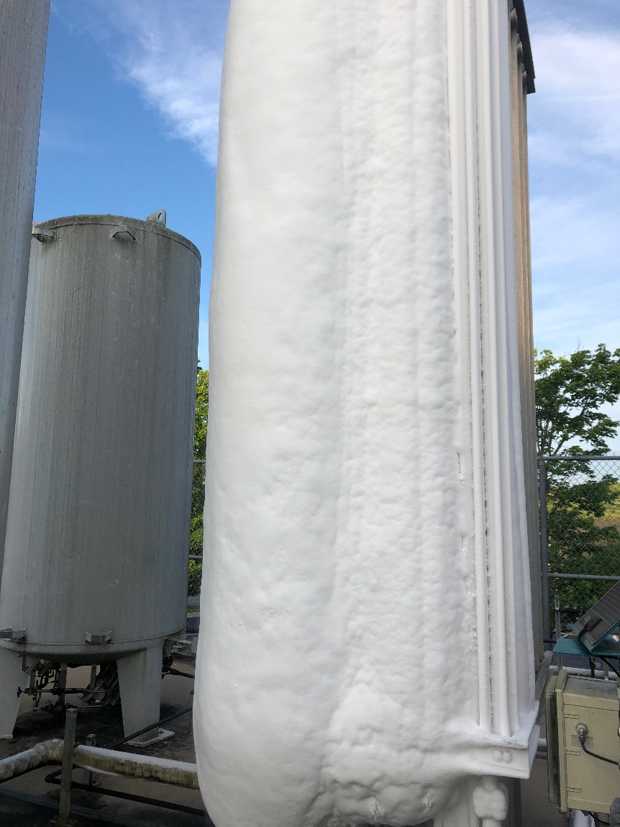
We Shouldn’t have Been Surprised
Almost 15 years ago I had a conversation with a government representative regarding the oxygen supply and a Pandemic.
We discussed the limitations of the bulk oxygen system

Slide 2
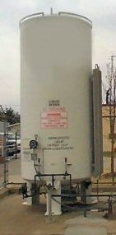
Weak Links in the Chain
Primary supply
Once a monthly delivery is optimal and most major gas suppliers try to design for this size.
LOX trailers are limited to ͌ 6000 gal. (͌ 690,000 scf)
The primary supply is not usually the weakest link in the chain.

Slide 3
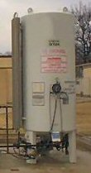
Weak Links in the Chain
Reserve Supply
Code requires alarming at “one average days supply”
This alarm setpoint needs to take into account
Tank heal (Unusable product)
Saturated gas. ͌ 96 scf/gal vs. ͌ 115 scf/gal
Most suppliers require 72 hours
The reserve supply is also not usually the weakest link in the chain.

Slide 4
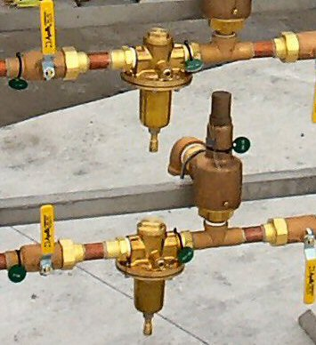
Weak Links in the Chain
System regulators
Typical 1” Generant/Rego ͌ 17,000 scfh in oxygen service
Diaphragms and seats are rated for -40°F to +165°F.
High flow applications XXXXX pilot operated regulators are used.
While regulators can be a wink link they are not the weakest link in the chain.

Slide 5
Weak Links in the Chain
Vaporizers
The problem child
Industry rating is at 70°F / 8 hours / 70%RH
At rated capacity output is 20°F below ambient
Capacities decrease:
With extended run time
Lack of air circulation
Lack of sun exposure

Slide 6
Weak Links in the Chain
Vaporizers
Proper sizing is critical
While there are sizing programs it is the old adage, “Garbage in garbage out”
Use rates typically based on historical usage, with some adders.
The vaporizers are the weakest link in the chain.

Slide 7
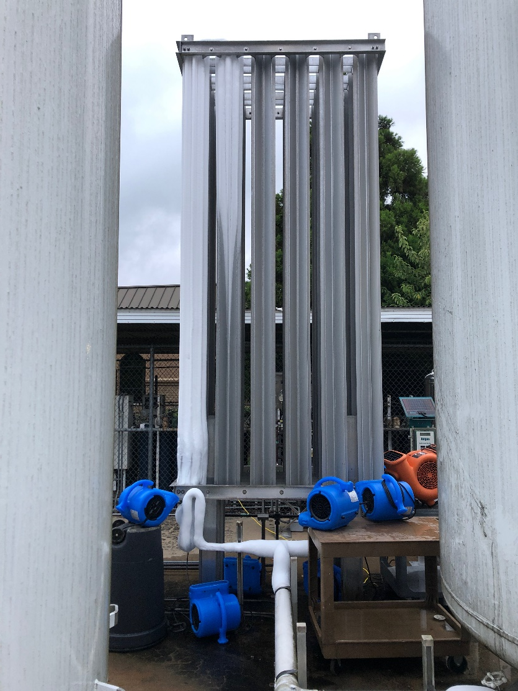
Short Term Solution
Increase air circulation

Slide 8
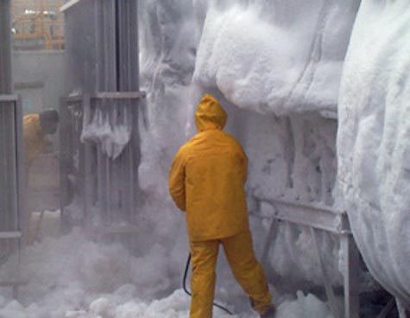
Short Term Solution
Deice the vaporizer
NOT LIKE THIS!!!!!

Slide 9
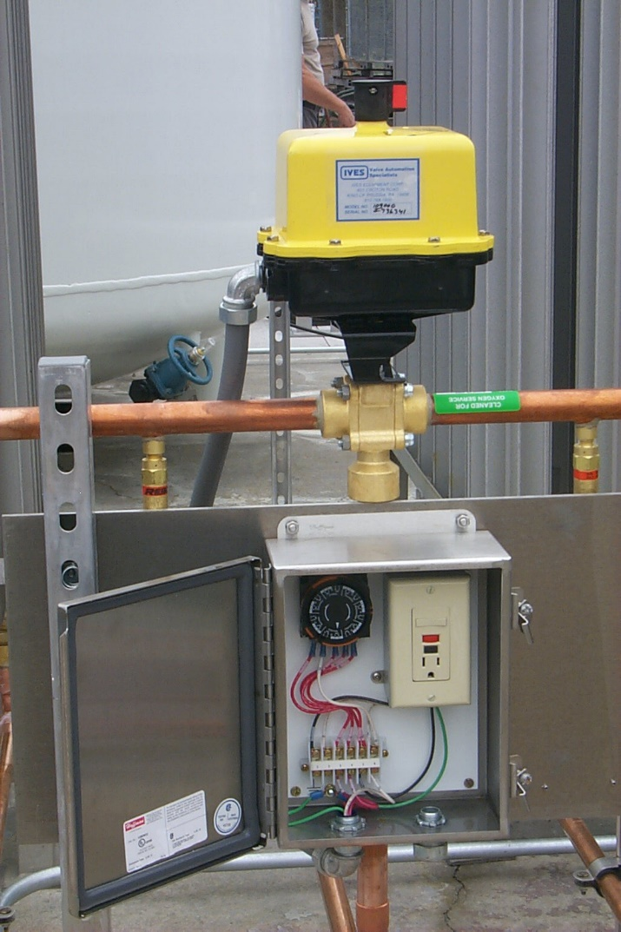
Long Term Solution
Resize based on the lessons learned.
Consider Switching
Allows a vaporizer to defrost
Easier to defrost heavily iced vaporizer
Air Circulation
Allows a vaporizer to defrost
Consider Powered Vaporizers

Slide 10
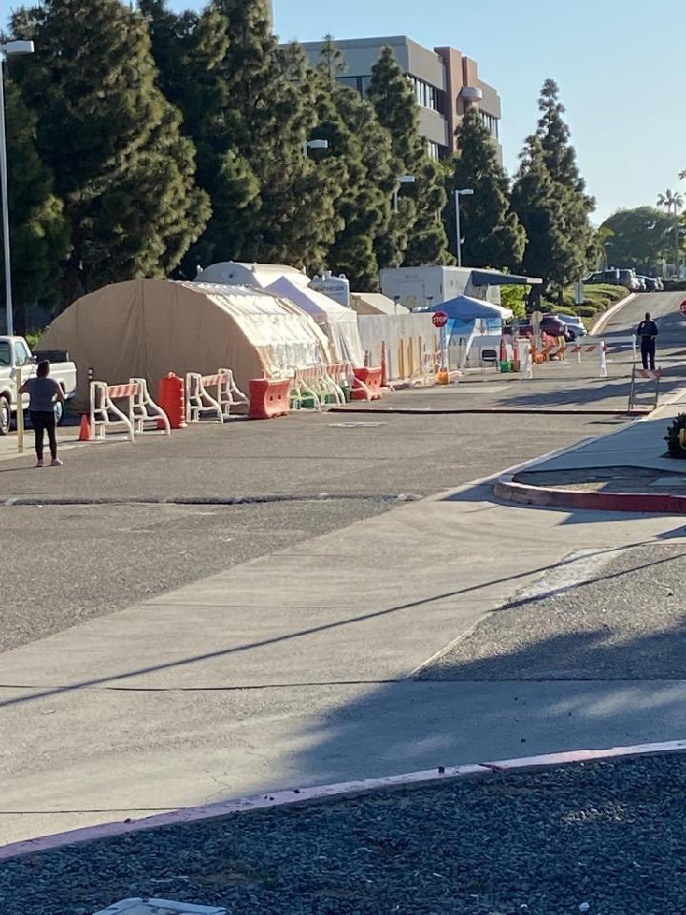
Think Before you Act!

Slide 11
CGA Standards for COVID-19 Response
The following CGA publications provide guidance on topics related to the industry’s response to the novel Coronavirus (COVID-19) pandemic.
CGA P-83, Guidelines for Cleaning Externally Contaminated Medical Gas Containers
CGA SA-35, Safety Alert, Cleaning of Cylinders Returned from Healthcare Facilities During a Pandemic
CGA C-10, Guideline to Prepare Cylinders and Tubes for Gas Service and Changes in Gas Service
CGA M-18, Standard for the Change of Product and Change of Grade for High Pressure and Refrigerated Liquid Containers
CGA SA-36, Safety Alert, Cylinder and Cryogenic Container Issue Related to Cylinder Conversion and Filling During the COVID-19 Crisis (1st ed)
CGA SA-37, Safety Alert, Medical Oxygen Supply System Issues During the COVID-19 Crisis (1st ed)

